Slide 1

Change

Slide 2


Believe it or Not?

Slide 3


Slide 4

Dream

Slide 5

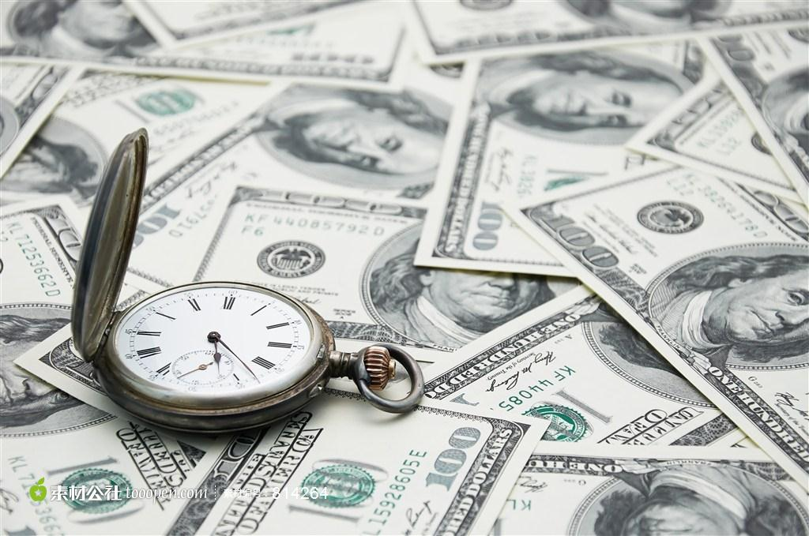

Slide 6
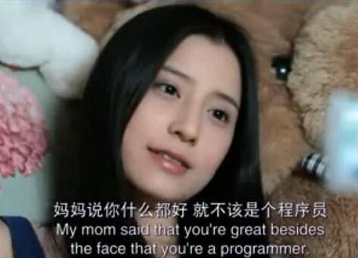

Slide 7
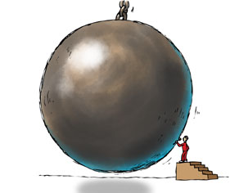

Slide 8
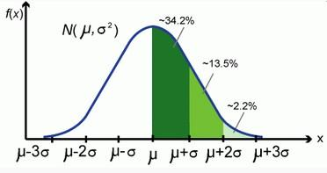
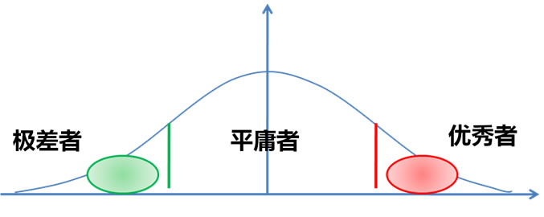
Normal Distribution
Super Weak
Average
Super Good

Slide 9
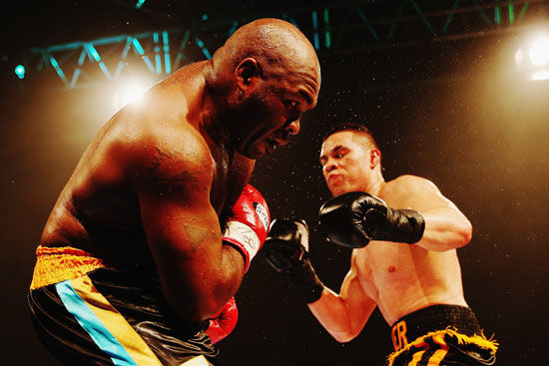

Slide 10

Give yourself a reason

